Slide 1

高级医学影像分析
汇报人：刘建

Slide 2

UniverSeg: 通用医学影像分割模型
UniverSeg: Universal Medical Image Segmentation
（CVPR 2023）

Slide 3
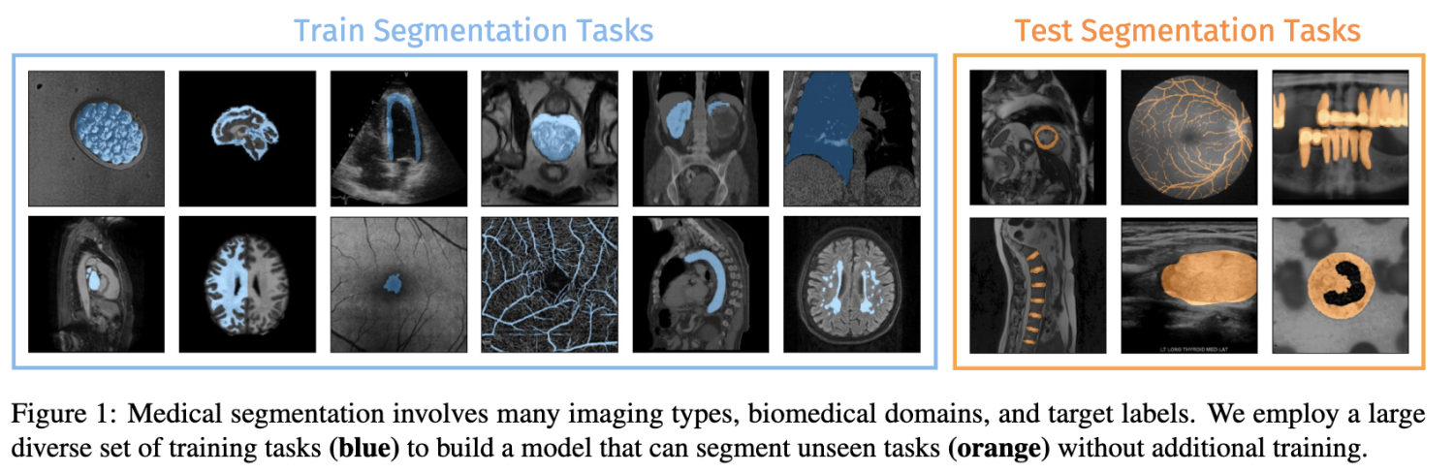
UniverSeg
Motivation and Background Introduction

Slide 4
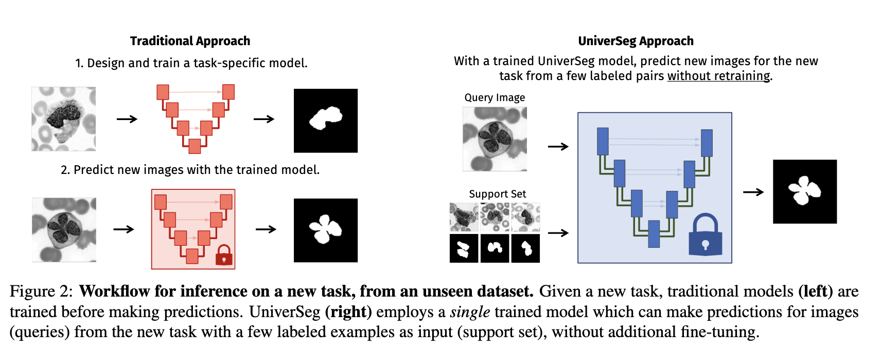
UniverSeg
Motivation and Background Introduction

Slide 5
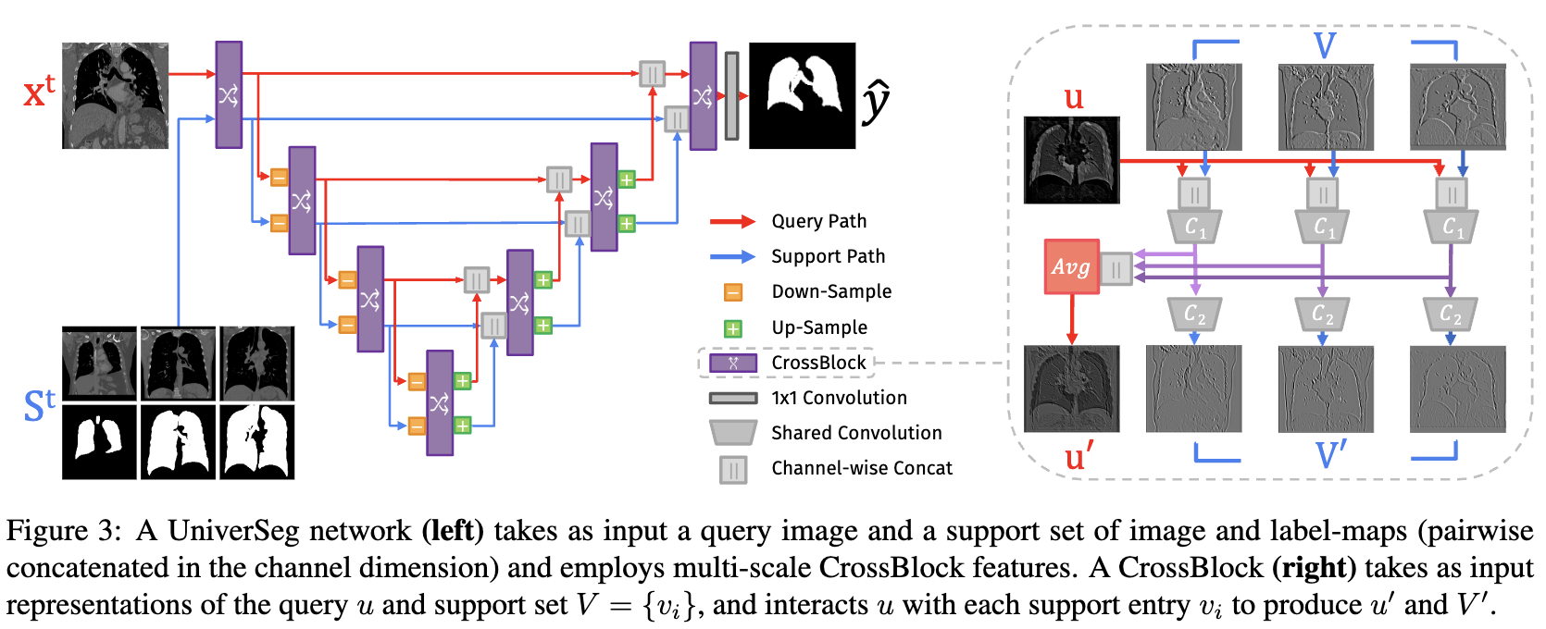
UniverSeg
Methods: The What and The How

Slide 6
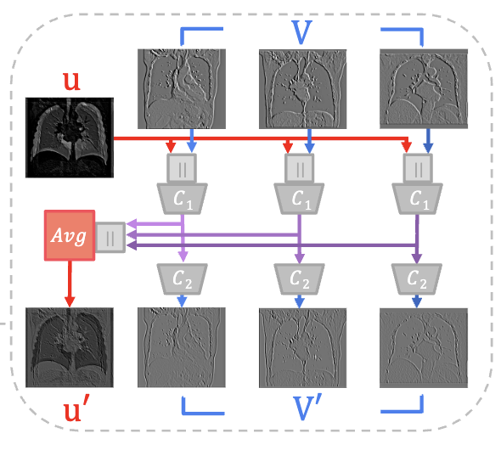
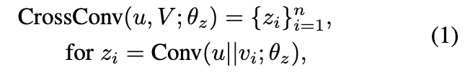
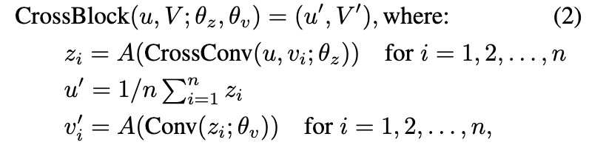
UniverSeg
Methods: The What and The How

Slide 7
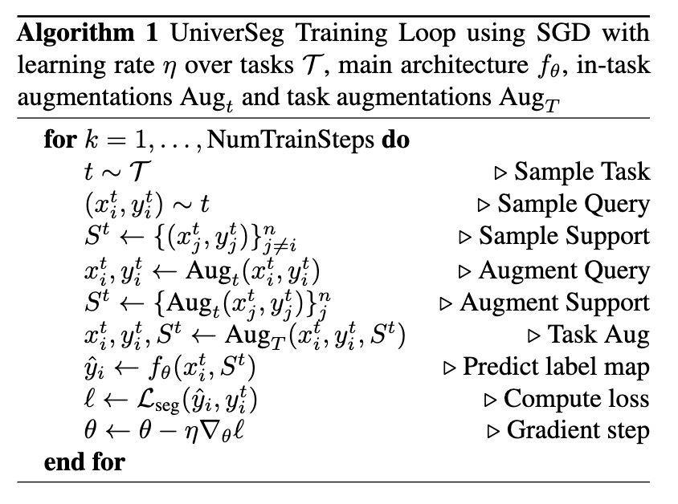
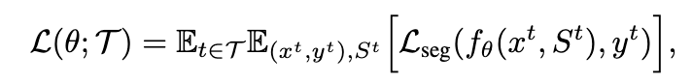
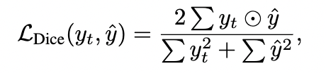
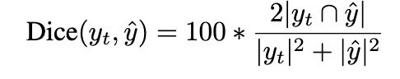
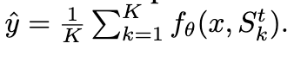
UniverSeg
Methods: The What and The How

Slide 8
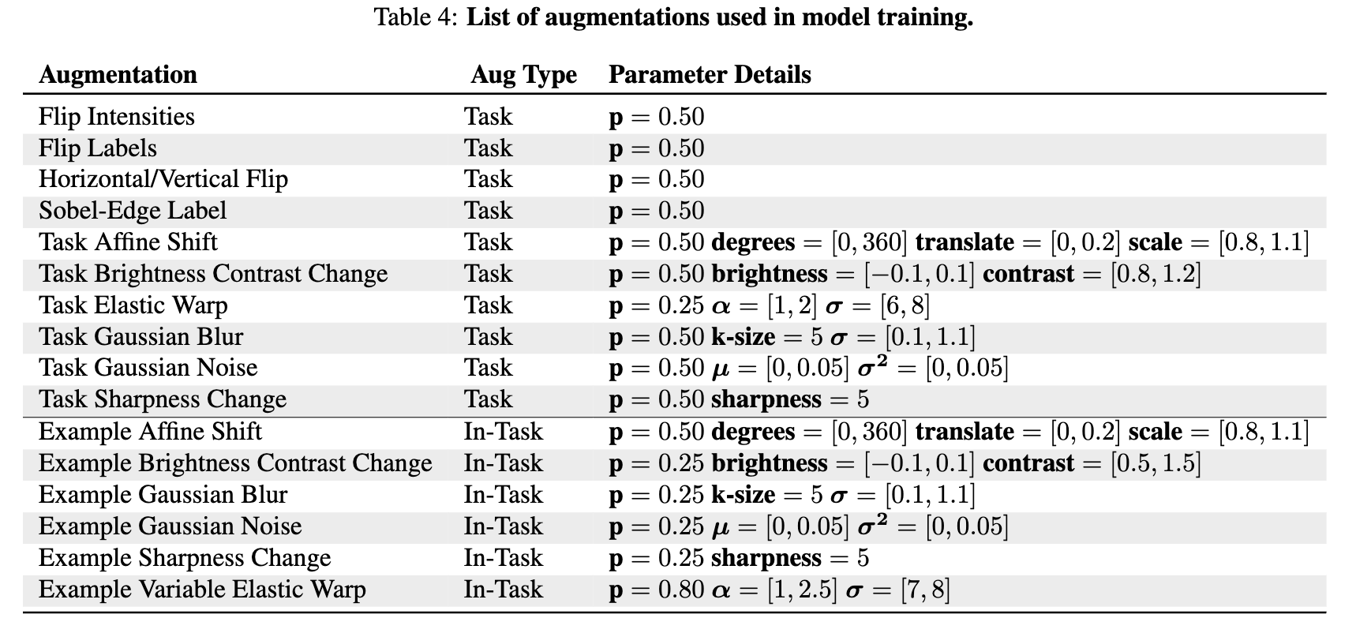
UniverSeg
Methods: The What and The How

Slide 9
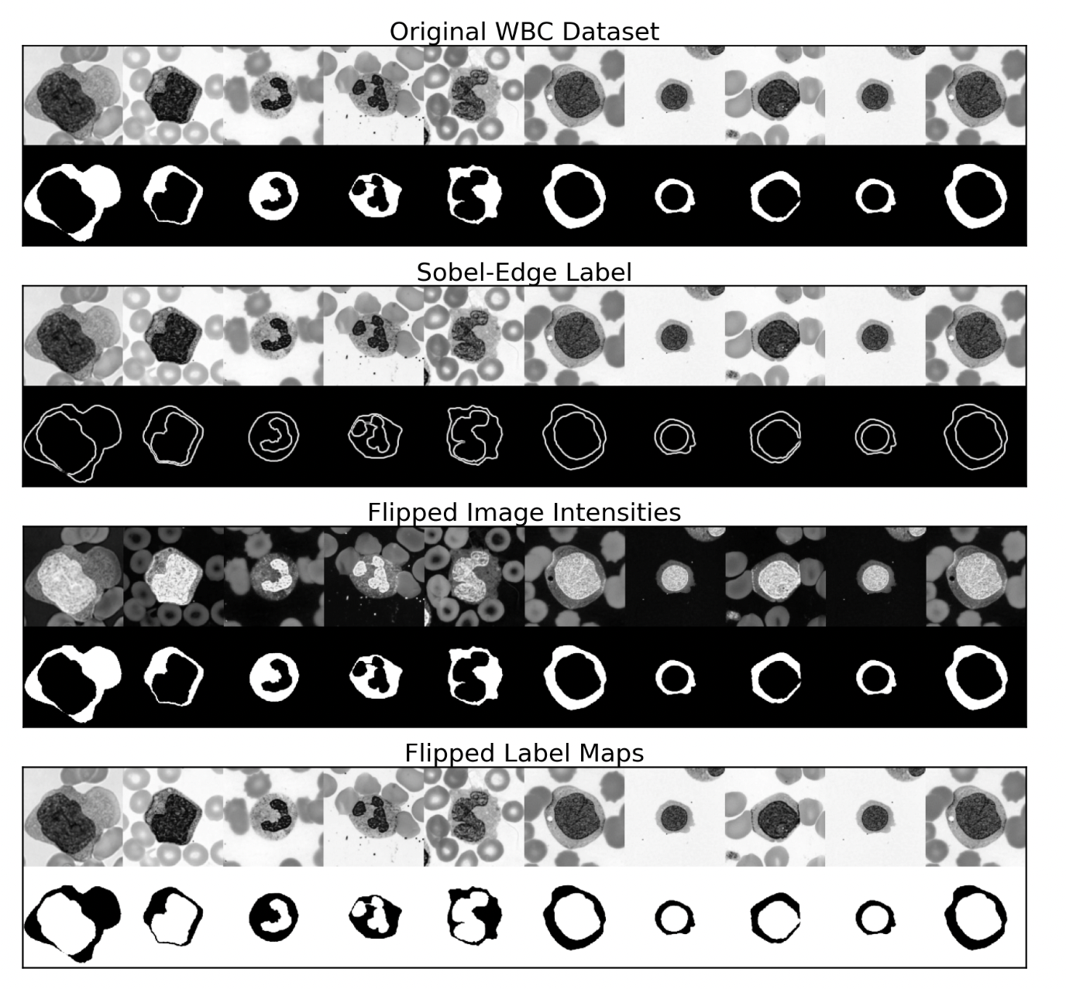
UniverSeg
Methods: The What and The How

Slide 10
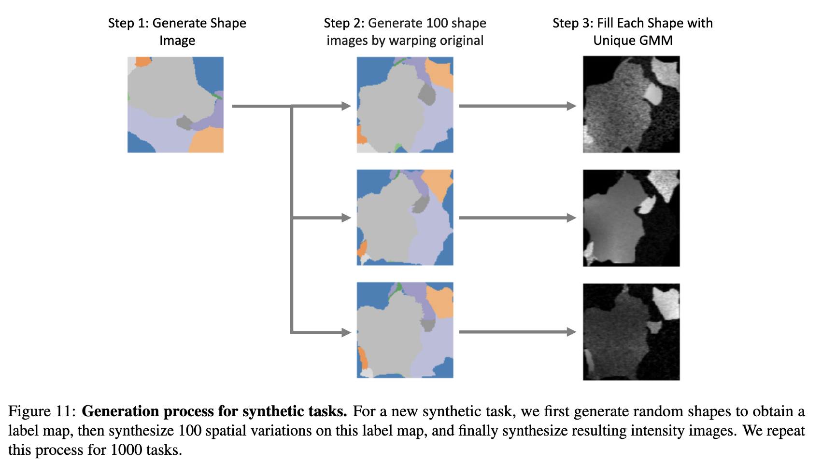
UniverSeg
Methods: The What and The How

Slide 11
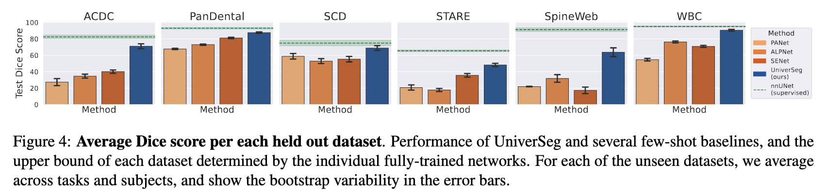
UniverSeg
The Results: Experimental Analysis
Notes:
data, ensemble

Slide 12
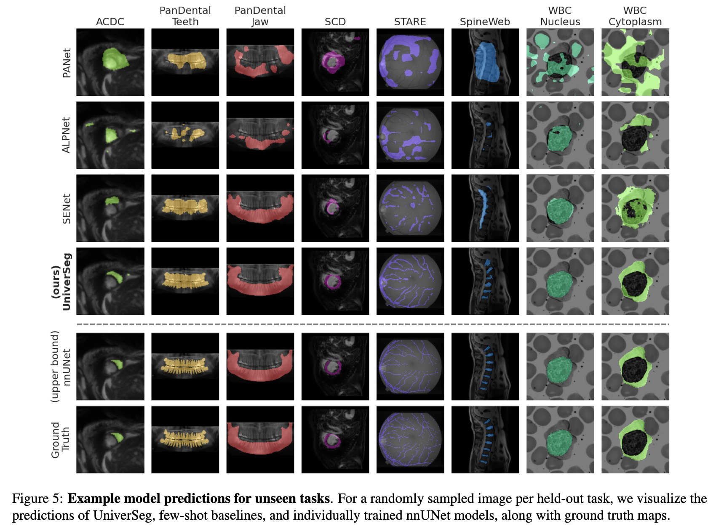
UniverSeg
The Results: Experimental Analysis

Slide 13
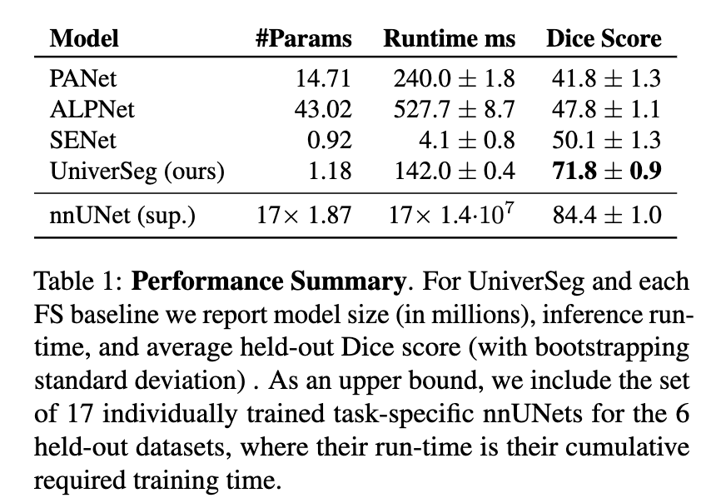
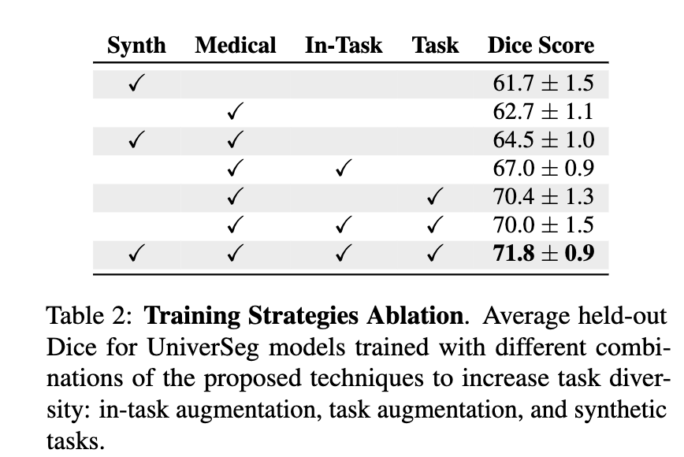
UniverSeg
The Results: Experimental Analysis

Slide 14
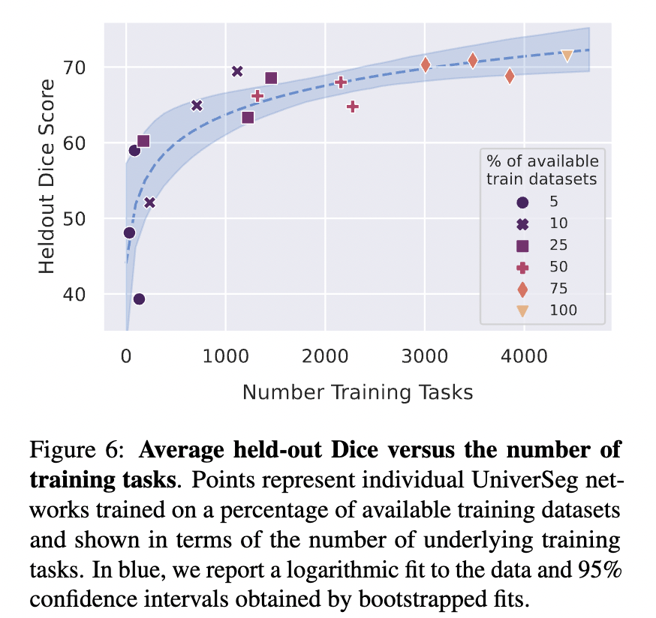
UniverSeg
The Results: Experimental Analysis

Slide 15
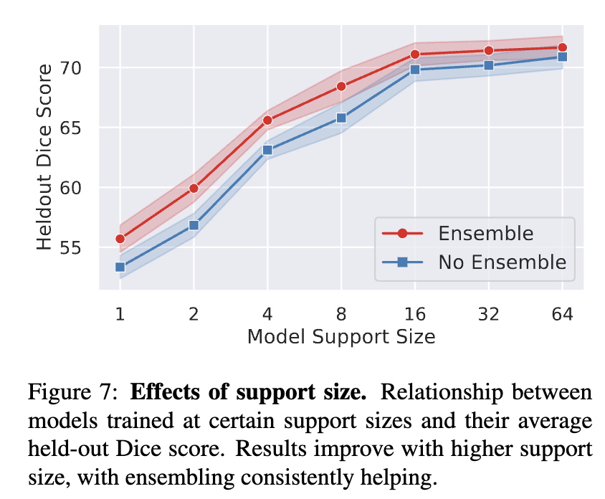
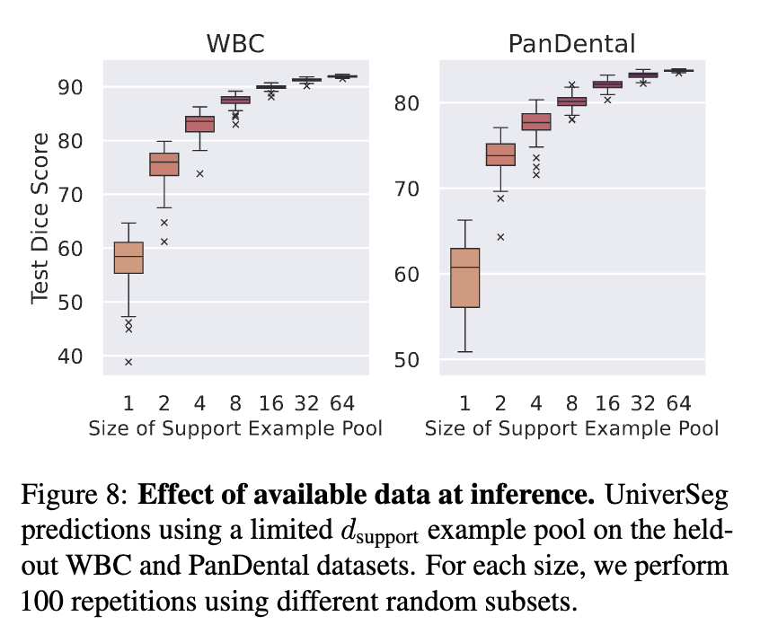
UniverSeg
The Results: Experimental Analysis

Slide 16
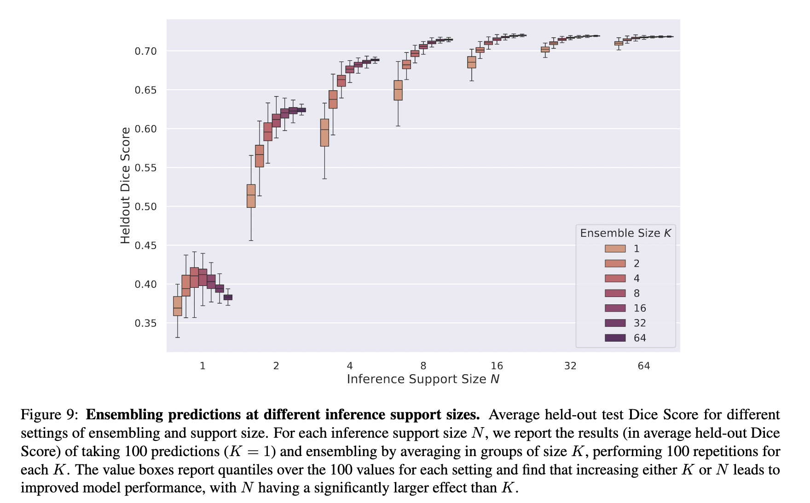
UniverSeg
The Results: Experimental Analysis

Slide 17
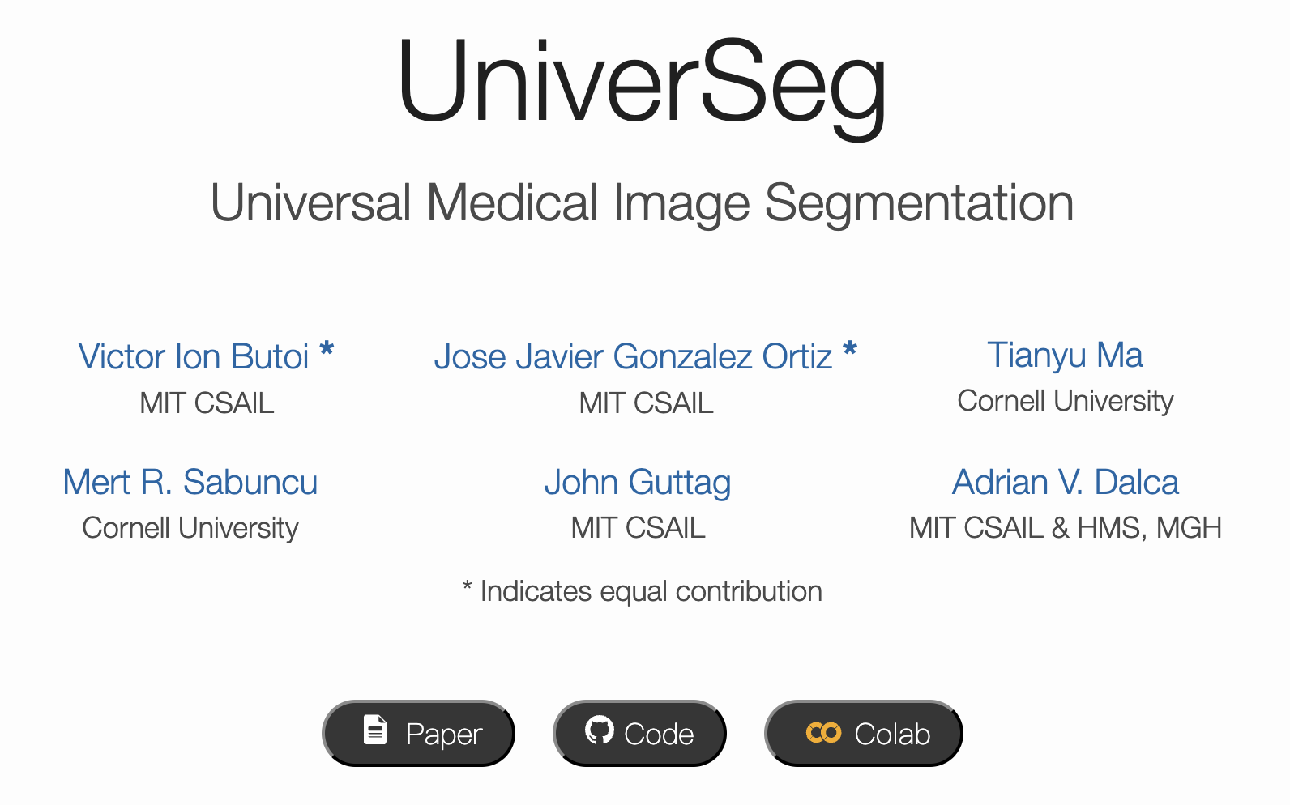
UniverSeg
Evaluating the Contributions of the Paper: Main Contributions and Innovations

Slide 18
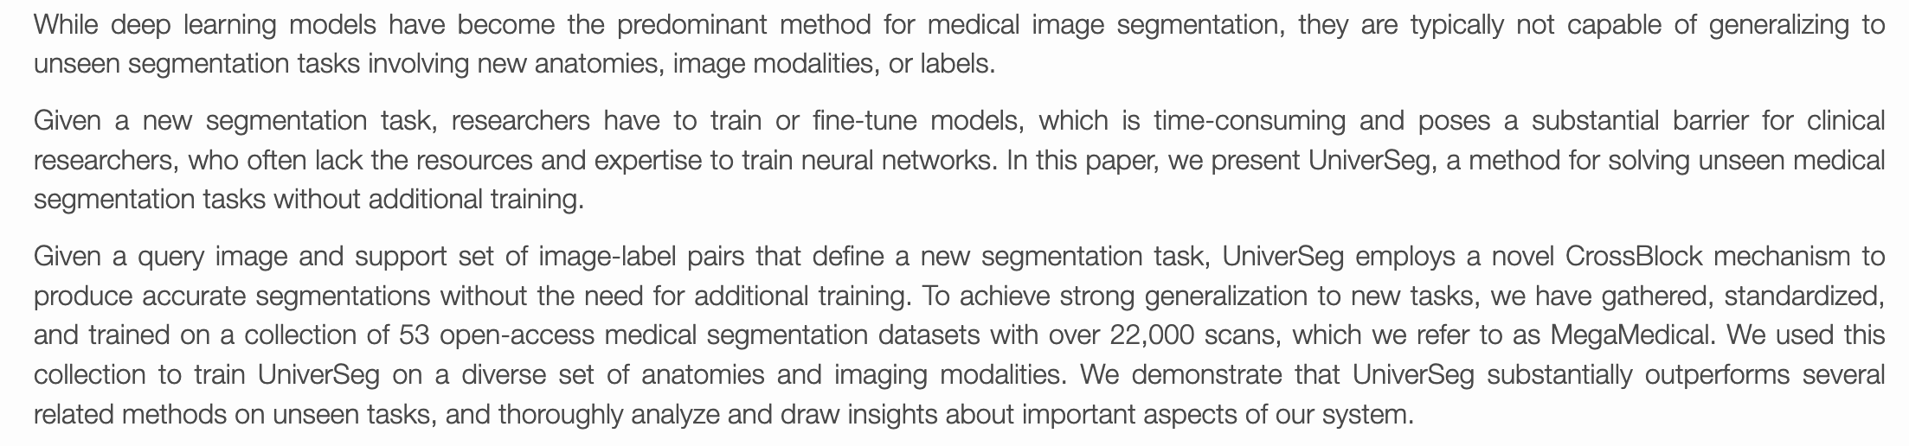
UniverSeg
Evaluating the Contributions of the Paper: Main Contributions and Innovations

Slide 19
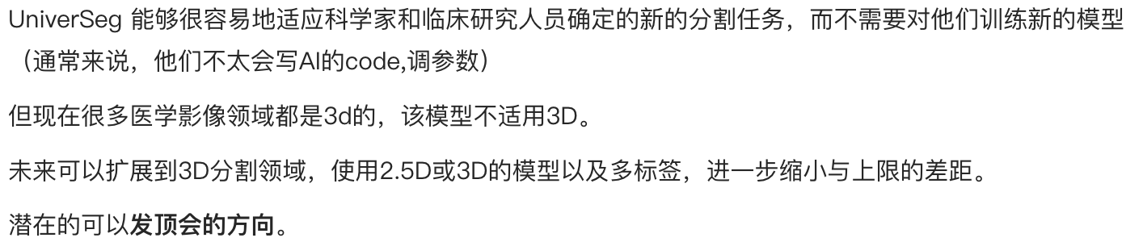
UniverSeg
Evaluating the Contributions of the Paper: Main Contributions and Innovations

Slide 20
感谢各位的倾听
规格严格
功夫到家
Thank You For Your Listening
2023年5月25日

